Slide 1
The Time Is Right For This Forum: Thanks for Your Participation
Daland R. Juberg, PhD
Chair

Slide 2
Thanks to the Scientific Liaison Coalition
A partnership of 13 societies that work to increase the awareness and impact of toxicology on human health and disease prevention

Slide 3
Organizing Committee
Daland R. Juberg, Chair, Dow Agrosciences
Thomas B. Knudsen, Co-Chair, US EPA
Richard A. Becker, ACC
Elaine M. Faustman, University of Washington
Suzanne Compton Fitzpatrick, US FDA
John R. “Jack” Fowle III, Science to Inform
Thomas Hartung, Johns Hopkins, CAAT
Ronald N. Hines, US EPA
Douglas A. Keller, Sanofi

Slide 4
Organizing Committee
Emmanuel Lemazurier, INERIS, France
John C. Lipscomb, US EPA
Donna L. Mendrick, US FDA
Raymond R. Tice, NIEHS/NTP (Retired)
David Watson, Lhasa Limited, United Kingdom
Alison Harrill, Univ. of AR Med. Sci,. CCT Liaison
George P. Daston, P & G Company, SOT Council Contact

Slide 5
Supporters
Diamond Level
Society of Toxicology
Scientific Liaison Coalition
American Chemistry Council
Dow AgroSciences, LLC
Platinum Level
The Hamner Institutes for Health Sciences
Human Toxicology Project Consortium, The Humane Society of the United States
National Institute of Environmental Health Sciences
US Food and Drug Administration, Office of the Chief Scientist

Slide 6
Supporters
Gold Level
Bayer Crop Science
NSF International
Syngenta Crop Protection LLC
TERA Center, University of Cincinnati
ToxServices
Silver Level
American Academy of Clinical Toxicology
American College of Toxicology
CAAT, Johns Hopkins
In Sphero
Lhasa Limited
Ramboll Environ
Safety Pharmacology Society
Society of Toxicologic Pathology
The Teratology Society

Slide 7
Supporter
Thanks to: US Environmental Protection Agency for Providing Student and Postdoctoral Scholar Award Support

Slide 8
Thank You
SOT Headquarters Staff

Slide 9
Thank You for Your Participation
This international congress provides a forum to bring together distinguished experts and attendees from academia, industry, government, and nongovernmental organizations (NGOs)
We are here today because of your commitment to advancing the science underpinning the evaluation and protection of human and environmental health
Your engagement is essential to facilitating the use of TT21C tools and approaches for ultimate application in regulatory decision-making

Slide 10
Welcome
Peter L. Goering, PhD, DABT, ATS
2015–2016 SOT President

Slide 11
SOT Central Challenge
Shaping the Future of Toxicology in a Changing Scientific Landscape
Building on success of FutureTox and Future Tox II
Continuing our journey across the “bridge of translation” by capitalizing on scientific advances and breakthroughs

Slide 12
Central Challenge
Shape the Future of Toxicology in
a Changing Scientific Landscape
BSOT
Strategic Map 2015-2018
A
C
Strengthen the
Impact and Relevance of Toxicology
Develop and
Support Toxicologists
to Capitalize on
Future Opportunities
Expand Outreach
and Impact Globally
Strategic
Priorities
1
1
1
Foster the
Integration of Other
Scientific Disciplines
with Toxicology
Clarify/Communicate
the Evolving Roles
and Skill Sets
for Toxicologists
Communicate the
Impact and Relevance
of Toxicology with
Key Audiences
2
2
2
Bridge Existing and
Emerging Science in
Toxicology
Increase Mutual
Understanding
Among Toxicologists
and Other Disciplines
Foster
International
Toxicology Activities
3
3
3
Strategic
Objectives
Promote
Transformative
Science in Toxicology
Promote the Recruitment, Education, and Development
of a Diverse and Creative
Community of Toxicologists
Increase Partnerships/
Collaboration with
Scientific Societies
4
4
4
Promote Translation of
Evolving Technology
into Clinic and Public Health
Promote
Opportunities for
Research Support
Be a Forum for
Discussion of Public
and Environmental
Health Policies/Issues

Slide 13
Exploring Central Questions?
What progress is being made to address challenges and opportunities in applying and implementing the emerging “big data” toolbox for risk assessment and regulatory decision-making?
What approaches and methods can bring about a safer and healthier world?
Notes:
Deleted 2nd bullet: What approaches and methods can bring about a safer and healthier world?

Slide 14
Strengthening the Impact and Relevance of Toxicology
Bridge Existing and Emerging Science in Toxicology
Promote Transformative Science in Toxicology
Promote Translation of Evolving Technology into Clinic and Public Health

Slide 15
Central Challenge
Shape the Future of Toxicology in
a Changing Scientific Landscape
BSOT
Strategic Map 2015-2018
A
C
Strengthen the
Impact and Relevance of Toxicology
Develop and
Support Toxicologists
to Capitalize on
Future Opportunities
Expand Outreach
and Impact Globally
Strategic
Priorities
1
1
1
Foster the
Integration of Other
Scientific Disciplines
with Toxicology
Clarify/Communicate
the Evolving Roles
and Skill Sets
for Toxicologists
Communicate the
Impact and Relevance
of Toxicology with
Key Audiences
2
2
2
Bridge Existing and
Emerging Science in
Toxicology
Increase Mutual
Understanding
Among Toxicologists
and Other Disciplines
Foster
International
Toxicology Activities
3
3
3
Strategic
Objectives
Promote
Transformative
Science in Toxicology
Promote the Recruitment, Education, and Development
of a Diverse and Creative
Community of Toxicologists
Increase Partnerships/
Collaboration with
Scientific Societies
4
4
4
Promote Translation of
Evolving Technology
into Clinic and Public Health
Promote
Opportunities for
Research Support
Be a Forum for
Discussion of Public
and Environmental
Health Policies/Issues

Slide 16
Overarching Meeting Objectives
George P. Daston, PhD
SOT Council Contact

Slide 17
Applying 21st Century Tools to Risk Assessment
Predicting health risks using computational (“big data”) approaches coupled with emerging biotech data streams
Engaging stakeholders in identifying risk assessment contexts and workflows for which new data streams are suited
Identifying challenges in implementing new methods for risk assessment and regulatory decision-making

Slide 18
FutureTox and FutureTox II Impacts and FutureTox III Outcomes
Thomas B. Knudsen, PhD, Co-Chair

Slide 19
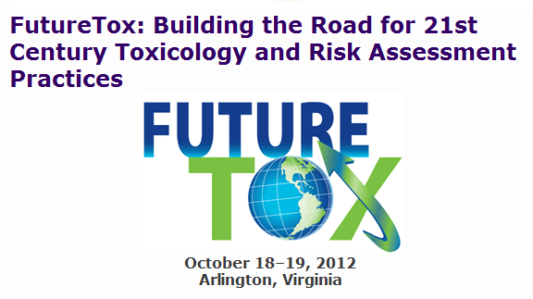
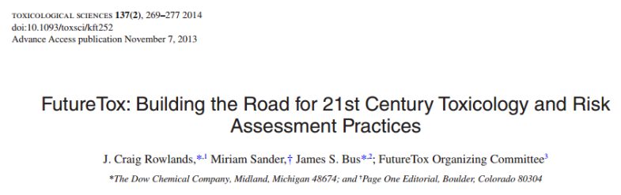
How we got here
Challenges and opportunities associated with effective and efficient implementation of the explosion of 21st century toxicity testing technologies and tools into improved, science-informed hazard prediction and risk assessment.

Slide 20

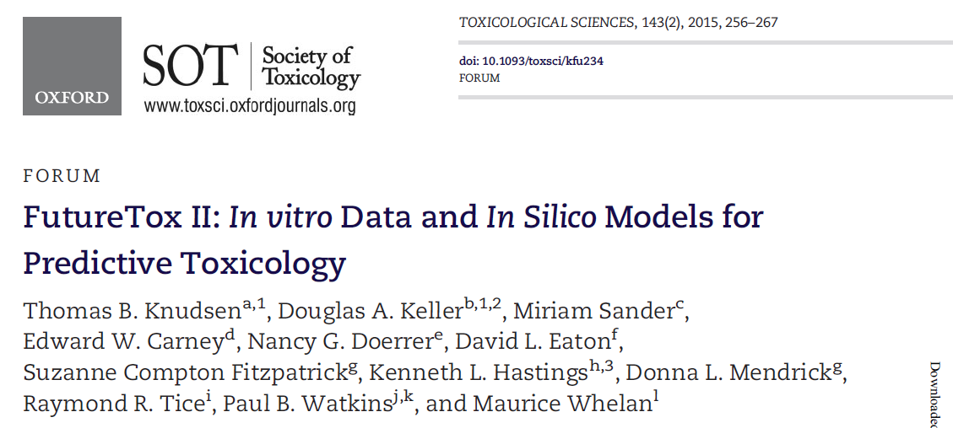
Scientific Liaison Coalition (SLC*) of societies, whose mission is to increase the impact of the science of toxicology to improve public health, joined forces with the HESI committee Distinguishing Adverse from Non-Adverse/Adaptive Effects that was concluding its mission.
* AACR, AACT, ACMT, ACT, ENDO, EMGS, ISSX, SPS, SRA, SETAC, STP, SOT, Teratology
Scientific progress & emerging technologies to improve predictivity of in vitro data, and in silico models coupled with systems biology, so that expectations can be managed in both the regulatory and regulated communities.
January 16-17, 2014
Chapel Hill NC

Slide 21


Building the risk assessment paradigm, taking the science of in vitro data and in silico models forward:
What progress is being made to address challenges and opportunities in applying and implementing the emerging “big data” toolbox for risk assessment and regulatory decision-making?
Pu
Manuscript for Toxicological Sciences:
- topical analysis of talks
- summary of BOGs
- summary of poster session
- and more …

